Slide 1
Politics and Economics during the Civil War
Chapter 18

Slide 2
President Abraham Lincoln
(1861-1865)

Slide 3
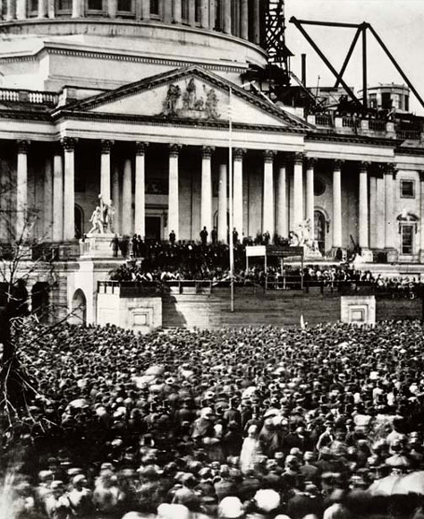
First Inaugural Address
He vowed to preserve the Union and to “hold, occupy, and possess” Federal property in the South
“Physically speaking, we cannot separate”
He was careful not to offend the border slave states with hawkish rhetoric
Republicans and Democratic unionists supported the speech
The lower South saw it as a war message

Slide 4
Lincoln’s Cabinet
Secretary of State: William H. Seward
One of America’s all-time most effective secretaries of state
In 1850 he had argued against the Compromise of 1850, especially the Fugitive Slave Law, arguing there was a “higher law” than the Constitution
Secretary of the Treasury: Salmon P. Chase
A leading abolitionist, he had presidential hopes that were dashed by Lincoln’s success
He oversaw a significant transformation of the nation’s financial system
Eventually, he was appointed by Lincoln as the Chief Justice to the Supreme Court
Secretary of War: Edwin M. Stanton
He was a “War Democrat” who was later appointed as Secretary of War to gain the support of pro-Union Democrats
He oversaw the eventual success of the Union army over the Confederacy
Cabinet was often at odds with each other or with Lincoln

Slide 5
Lincoln as a leader
He was perceptive at interpreting public opinion and acting accordingly
He was charitable towards the South and patient with feuding cabinet members
Despite deep differences with some of his cabinet members, he shrewdly presided over the cabinet to achieve his goals

Slide 6
Attack on Fort Sumter

Slide 7
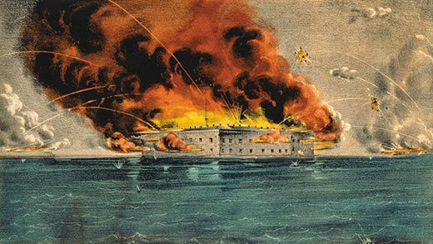
Fort Sumter
Located at the mouth of Charleston Harbor, Ft. Sumter was one of the two last remaining federal forts in the South
The day after Lincoln’s inauguration, Lincoln was notified by Major Robert Anderson that supplies to the forts would soon run out and he would be forced to surrender
Confederate General P.G.T. Beauregard gave Anderson an ultimatum to give up the fort or face an attack

Slide 8
Lincoln’s Options
Lincoln was faced with choices that were all bad
Providing no supplied would mean surrender; this would ruin his credibility to “hold, posses, and occupy” federal forts
Sending reinforcements would surely provoke the South into a civil war with the North seen as the aggressor
Union detachments were not available on such short notice thus limiting Lincoln’s military option
Solution: Lincoln notified South Carolinians of an expedition to send supplies to the forts, not to reinforce it with men or weapons
If a war were to begin, Lincoln would let the South fire the first shot
April 9, 1861: A ship carrying supplies for Fort Sumter sailed from New York
South Carolina saw it as an act of aggression; military “reinforcement”

Slide 9
Attack on Fort Sumter
On April 12, Fort Sumter was bombarded by more than 70 Confederate cannons
Signaled the beginning of the Civil War
Anderson’s garrison held for 34 hours until he surrendered at 2:30 PM the next day
Anderson’s men were allowed to return north
No loss of life during the bombardment; fort heavily damaged

Slide 10
Lincoln’s Response
Before the attack, many northerners felt that the South had the right to secede and should not be forced to stay
The attack on Fort Sumter provoked the North to fight for their honor and the Union
Lincoln’s strategy paid off; the South was seen as the aggressor while the North was seen as the victim
On April 15, Lincoln issued a call to the states for 75,000 militiamen for 90 days of service
On April 19, Lincoln proclaimed a blockade of Southern seaports
Initially ineffective but eventually strangled the South
May 3, Lincoln issued a call for 3-year volunteers as the 90 day militiamen would not be sufficient
Until April 25, Washington DC was virtually under siege and a Confederate attack on the capital was expected
Never came

Slide 11
More secession
Four more states would secede from the Union
Virginia, Arkansas, Tennessee, and North Carolina
Northerner calls for troops aroused the Middle South who viewed Lincoln as waging war
Richmond replaced Montgomery as the Confederate capital

Slide 12
The Border Slave States

Slide 13
Border Slave States
The Border Slave States (Missouri, Kentucky, Maryland, and West Virginia) remained in the union as the North did not start the war
Crucial to the Union cause; sent 300,00 soldiers to the Union Army
“Mountain white” population in the South sent 50,000 soldiers to the Union army
Lincoln: Hoped to have God on his side but he had to “have Kentucky”
West Virginia left Virginia in mid-1861 to join the Union; large “Mountain white” population
Border South had over 50% of the South’s white population and fewest number of slaves
This, the was began with slaveholders on both sides
Brothers and family members were often split and fought on opposite sides

Slide 14
Lincoln and the Border States
Lincoln used force at times to maintain control of the border states
He declared martial law in Maryland in certain areas and sent troops since some Marylanders threatened to cut off Washington DC from the North
Troops were also sent to West Virginia and Missouri (where a mini-civil war raged)
Politically, Lincoln had to keep the border states in mind when making public statements
He declared the primary purpose of the war was to preserve the Union at all costs
He declared the North was not fighting to free the slaves
An emancipation edict would have driven the borer states to the South
Lincoln was heavily criticized by abolitionists who saw him as a sellout

Slide 15
Lincoln in August 22, 1862 to Horace Greeley
:My paramount object is to save the Union, and is not either to save or destroy slavery… If I could save the Union without freeing any slave I would do it, and if I could save it y freeing all the slaves I would do it, and If I could save it by freeing some and leaving others alone, I would also do that.”
This Photo by Unknown Author is licensed under CC BY-SA

Slide 16
Confederate Assets

Slide 17
Confederate Assets
Possessed the advantage of a defensive war strategy
They only needed a stalemate, not outright victory; fewer troops could defend a larger invading northern army
The Union would have to invade, conquer, occupy, and reintegrate the South into the Union
Until the emancipation proclamations of 1862 & 1863, many felt the South had the superior moral cause, slavery notwithstanding
Confederates fought for self-determination, its culture, its homeland and freedoms (for whites)

Slide 18
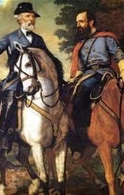
Confederate Assets (Continued)
The Confederate Army had superb military officers
Robert E. Lee: one of the greatest military leaders in US history
Was opposed to slavery and spoke against secession in January 1861
Lincoln had offered Lee command of the Union armies but Lee decided to protect his naïve Virginia after she seceded
Thomas J. “Stonewall” Jackson
Lee’s chief lieutenant and premier cavalry officer
Top Union generals in the east were inept during the first 3 years of the war until replaced by more able generals from the west
Southern men made strong cavalry and infantrymen
Accustomed to a hard life and management of horses and guns while large numbers of northerners moved away from agriculture during the Market Revolution

Slide 19
Confederate Weaknesses

Slide 20
Confederate Weaknesses
A lack of significant industrial capacity was a crucial disadvantage as the South was primarily agricultural
As the war dragged on, severe shortages of shoes, uniforms, and blankets adversely impacted Rebel soldiers
Southern railroads were cut or destroyed by the Union army
The Confederacy didn’t get its much-needed foreign intervention
Confederates might have won if
One or more border states had seceded
Upper Mississippi Valley states had turned against the Union
Northern public opinion demanded a peace treaty
England and France broke the Union blockade and recognized the Confederacy

Slide 21
Northern Advantages

Slide 22
Northern Advantages
Enjoyed a population of 22 million and 800,000 new immigrants between 1861-63
The South only had 9 million people including 3.5 million slaves
Union Army’s numerical advantages over Lee were 3 to 2 or even 3 to 1
20% of the Union Army was foreign-born
Thousands of Irish immigrants were recruited for the Union army as soon as they disembarked their ships
The Union had ¾ of the nation’s wealth
Overwhelming superiority in manufacturing, shipping, and banking
The North had 75% of the nation’s railroads and could easily repair and replace rails

Slide 23
Northern Advantages
The Union controlled the sea through its blockade of southern ports
The ideal of Union aroused the North against the South; “Union Forever”
This was significant in keeping the border states and upper Mississippi states from seceding
The cry for Union gave the North a strong moral issue until the emancipation of slaves was added to it later
The Union had much better logistical planning in the army and better weaponry

Slide 24
The Confederate States of America

Slide 25
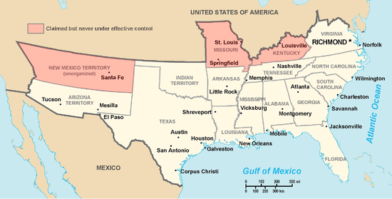
The CSA
The Confederates drafted a constitution that was in many ways identical to that of the Union
Fatal flaw: the Confederacy was created by secession, it could not deny future secession if a southern slave state sought to go its own way
Jefferson Davis’ idea of a strong central government was bitterly opposed by states’ rights advocates
Some states didn’t want their troops to fight outside their own borers
Davis was often at odds with his Congress; in danger of being impeached at one point
Davis lacked Lincoln’s political savvy

Slide 26
European Diplomacy During the War

Slide 27
European Support
The monarchies of England, France, and Austria-Hungary supported the Confederate cause
Democracy was hated by aristocrats as the Union was a powerful symbol of democracy
Democracy was a threat to the old order
Britain sympathized with the aristocratic society of the South
They sought to break up the United States
Europeans sold weapons, warships, and supplies to the Confederates
At times, they considered direct intervention on behalf of the South, especially Britain
British industrial and commercial centers wanted an independent Confederacy
Wanted a safe cotton supply without Union’s blockade or interference
British shippers and manufacturers could then bypass Union tariffs

Slide 28
Failure of King Cotton
In 1861, Britain had an oversupply of cotton
By the time Britain badly needed cotton again, Lincoln had issued the Emancipation Proclamation giving the North the superior moral cause
Working people in England, and to some degree France, supported the North and hated slavery; they influenced their governments to remain neutral
As Union armies captured the South, the North shipped huge supplies of cotton to England
Booming war industries in England that supplied the North and South alleviated British unemployment
Huge amounts of northern grain was shipped to Britain who had suffered through bad harvests

Slide 29
British Neutrality and its notable exceptions
Trent Affair of 1861
A Union warship north of Cuba stopped a British ship en route to England and apprehended two Confederate diplomats
The US captain erred as he should have brought the ship to port for proper judgement
In response, Britain prepared for war against the US, sent troops to Canada
Lincoln decided to reluctantly release the diplomats as he did not want to fight a second war
Britain was an unofficial naval base for the Confederacy until 1863
Confederate commerce-raiders, such as the C.S.S. Alabama, were being built in Britain
Over 250 US merchant ships were captured by the Confederates
Yet, the Union’s war effort was not crippled by Confederate commerce-raiders

Slide 30
French Diplomacy
French leader Napoleon III treated the Union with contempt
1863, Napoleon III sent troops to conquer Mexico in violation of the Monroe Doctrine
During Civil War, the US was cautious toward France
Did not want to fight a world war
After the Civil War, Secretary of State Seward prepared to send US forces to Mexico to drive out the French
Napoleon III abandoned Mexico and she once again became independent
Bolstered the prestige of the Monroe Doctrine

Slide 31
Raising Armies: North and South

Slide 32
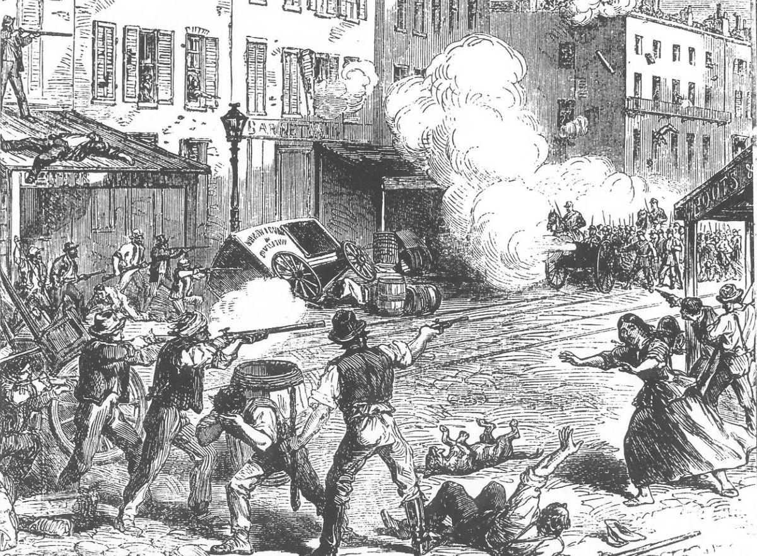
Northern Troops
Initially, northern armies were comprised of volunteers with each state given a quota based on population
~90% of the Union army
In 1863, Congress passed the first-ever federal conscription law in US history
Needed to make up for fewer numbers of volunteers
Policy was unfair as wealthier youth could hire substitutes for $300
The draft was most hated in the Democratic strongholds of the North
The New York Draft Riot of 1863 was sparked by Irish Americans against blacks that resulted in nearly 500 lives lost and many burnt buildings
Large bounties for enlistment were also offered by federal, state, and local authorities
About 200,000 deserters of all classes avoided military service; the South experienced similar problems with desertion

Slide 33
Southern Troops
Initially, the South relied on volunteers
Its smaller population meant numbers of troops were smaller
The Confederacy was forced to conscript men between the ages of 17 and 50 as early as April, 1862
1 year earlier than the Union
Rich men could hire substitutes or purchase exemptions
Mountain whites refused to enlist

Slide 34
African American soldiers in the North
About 180,000 African Americans served in Union armies; about 10% of total Union enlistments; 38,000 died during war
Most came from slave states
Black volunteers were initially rejected
The initial war aim of the Union was not to end slavery but to preserve the Union
Many whites were overcome by racism and fear in arming African Americans
By 1862, the need for soldiers and impending emancipation opened door to black volunteers
Lincoln later claimed the Union’s victory was largely due to the impact of the black regiments
Black soldiers were particularly inspired to fight for the freedom of their families or for increased rights after the war

Slide 35
African American troops in the South
The Confederacy did not enlist slaves until a month before the war ended
Thousands of slaves were forced into labor battalions, building fortifications, supplying armies, and other war-connected activities
Slaves kept the southern farms going while the southern white men fought
Ironically, slaves didn’t revolt back home (despite learning of the Emancipation Proclamation)
Many slaves abandoned plantations when Union armies arrived

Slide 36
Native American troops
Native American Territory: Most of the Five Civilized Tribes sided with Confederacy including the Cherokee, Creek, Choctaw, Chickasaw, and Seminoles
The Creek and Choctaw owned slaves
Nearly 29,000 Native Americans served in the Union and Confederate armies

Slide 37
Civil War Economics

Slide 38
Northern Revenues
The first income tax in the nation’s history was passed by Congress in 1862
Relatively small but it paid for 2/3 of the war’s cost
Excise taxes on tobacco and alcohol were substantially increased by Congress
Morrill Tariff Act of 1861: raised the low Tariff of 1857 by about 10%
It was about the level of the Walker Tariff of 1846
Tariff rates were later raised significantly due to demands of revenue and protection during war
The protective tariff came to be associated with Republicans for the next 70 years and became the dominate issue in post-Civil War politics during the 1870s and 1890s

Slide 39
Northern Revenues (Continued)
Sale of bonds through the US Treasury were marketed through the private banking house of Jay Cooke & Co. which earned enormous monies from commissions
National Banking System was authorized by Congress in 1863
It was designed to establish a standard bank-note currency
At the outset of the war, the North was flooded with depreciated “rag money” issued by unreliable bankers
Greenbacks became America’s first national currency
About $450 million was issued at face value to replace gold
Greenbacks were supported by gold; their values was determined by the nation’s credit
Though fluctuating during the war, Greenbacks held their value well after the Union’s victory
Also sold government bonds
Banks joined the NBS could buy bonds and issue sound paper money back by the system
The new bank constituted the first national bank since Jackson killed the BUS in 1832
It lasted 50 years until the creation of the Federal Reserve System in 1913

Slide 40
Southern Finances
Customs duties were cut-off due to the Union
The government issued about $400 million of bonds sold at home and abroad
Significantly increased taxes, including a 10% tax on farm products
Most states’ rights Southerners hated heavy direct taxation by the Confederate government
Yet, direct taxation accounted for only 1% of government revenues
Biggest source of revenue: Confederacy printed large amounts of paper money
Runaway inflation occurred as the treasury cranked out more than $1 billion
Inflation of currency coupled with taxes on farm produce actually worked until the end of the war

Slide 41
War-time Prosperity in the North
The Civil War produced the first millionaire class in US history
New factories protected by the new tariff emerged
Marked the ginning of the “Gilded Age” dominated by “Captains of Industry” (Robber Barons)
New labor-saving machinery spurred expansion while the best laborers were fighting in the war
Sewing machine, mechanical reapers, etc.
The petroleum industry was born in Pennsylvania in 1859 that led to the vast production of kerosene for lighting lamps

Slide 42
War-time prosperity in the North (continued)
Homestead Act of 1862
Provided free land to pioneers heading to unsettled lands out west
Many went west to escape draft
Flood of settlers after the war, many were veterans
Gold seekers in NV and CA would later constitute a formidable mining frontier with the completion of the transcontinental railroad
Morrill Land Grant Act of 1862
Each state received 30,000 acres of public lands for each senator and congressman in Congress
Profits from sale of lands financed agricultural and mechanical colleges in each states
Southern states who rejoined the Union enjoyed the same terms
The law became the foundation of state college systems throughout the West in the late 19th and 20th centuries

Slide 43
War-time prosperity in the north (Continued)
Pacific Railway Act of 1862
Commissioned a transcontinental railroad to be built connecting the northern states and territories to CA
Completed in 1869, the transcontinental railroad became perhaps the most important economic and technological event of the 19th century
Stimulated the development of major industries (steel, ranching, mining, agricultural production)
The only Northern industry to suffer was overseas shipping due to Confederate commerce-raiders

Slide 44
Demise of the Cotton Kingdom
The Union blockade resulted in severe shortage metals and other materials for military purposes
The destruction done by Union armies ruined the southern economy
The southern rail system was destroyed
The South was eclipsed by the new 2nd Industrial Revolution of the North
The logistical superiority of the Union, especially the use of its vast railroad network, eventually overwhelmed the South

Slide 45
Lincoln and the suspension of Civil Liberties

Slide 46
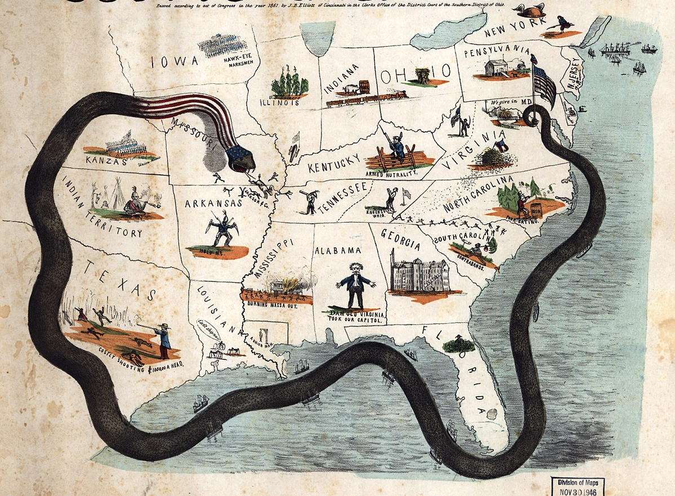
Lincoln and the suspension of civil liberties
As a war-time president, Lincoln bent the Constitution and suspended certain civil liberties
Motive: Saving the Union required circumventing some areas of the Constitution
Congress generally accepted or approved Lincoln’s acts
The suspension of liberties was not total but more than any other period of US history
Lincoln fully intended to restore civil liberties once the Union was preserved
The Blockade (Anaconda Plan) was proclaimed by Lincoln when Congress was not in session
Lincoln’s action was later upheld by the Supreme Court

Slide 47
Lincoln and the suspension of Civil liberties (Continued)
He increased size of federal army and navy (without Congressional approval)
The Constitution states that only Congress can do this
His actions were later approved by Congress who actually increased appropriations and the size of the army
He extended volunteer enlistments to three years (without Congressional approval)
He advanced $2 million to three private citizens for military purposes (without Congressional approval)

Slide 48
Lincoln and the suspension of Civil liberties (Continued)
He suspended the writ of habeas corpus so that anti-Unionists could be arrested and kept in prison
Ex Parte Merryman, 1861: Chief Justice Roger Taney ruled that habeas corpus could only be set aside by Congress
864 people were held without a trial during the first nine months of the war
Lincoln ignored Taney’s report and took no action
Significance: During the crisis of wartime, the President could bend the law for the welfare of the country, including suspending the Court’s authority
In 1863, Congress approved Lincoln’s action
After 1862, arrests increased for spies, smugglers, blockade-runners, and foreigners

Slide 49
Lincoln and the suspension of Civil liberties (Continued)
He arranged for the Union Army to oversee voting in Border States
Voters holding colored ballots indicating party preference had to walk between two lines of armed troops who were protecting against election fraud and voter intimidation by pro-southerners
Democrats and pro-southern critics claimed that this “supervised” voting actually intimidated voters who were not Republican or who had southern sympathies
Federal officials also suspended certain newspapers and arrested their editors for obstructing the Union war cause
This can be viewed as a direct violation of the First Amendment to the Constitution
Lincoln signed a bill outlawing slavery in all the national territories even though it conflicted with the Dred Scott Case

Slide 50
Lincoln and the suspension of Civil liberties (Continued)
In general, civil liberties and constitutional rights were respected during the war
Few political opponents were arrested; this is a stark contrast to the way dissenters were dealt with in Europe in Europe’s numerous 19th century revolutions
Jefferson Davis, unlike Lincoln, was unable to exercise arbitrary power
The South seemed more willing to lose the war than surrendering state or local rights

Slide 51
The Civil War was the first “modern” war (“total war”)

Slide 52
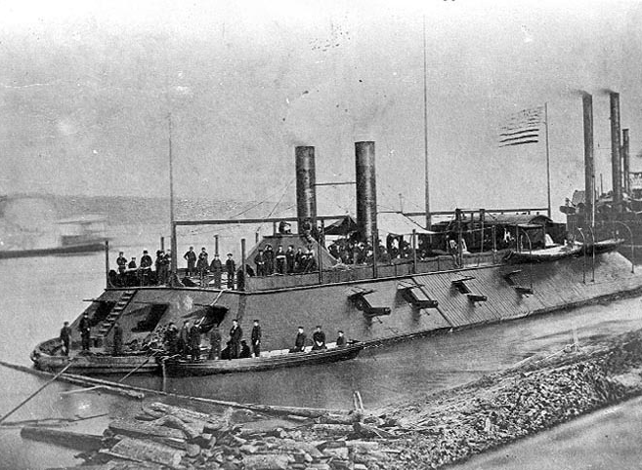
The first modern war
Civilians eventually became targets of enemy armies
Southern plantations were intentionally destroyed by Union armies
Some southern cities experienced utter destruction
Much of society’s resources were allocated to the war effort
Massive size of Civil War armies foreshadowed 20th century conflicts
Modern technology and logistics
The Minie ball used in both Union and Confederate muskets were devastating to soldiers
Ironclads foreshadowed steel navies
The railroad transformed war logistics

