Slide 1
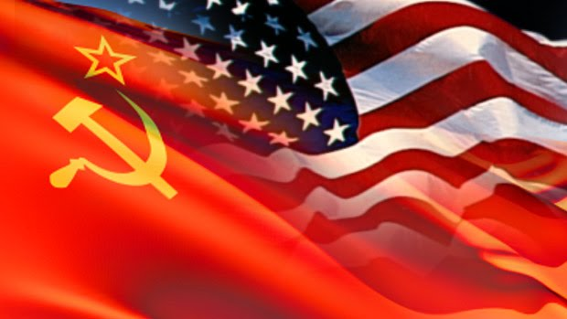
Cold War: Containment Policy
President Truman and the Cold War

Slide 2
Roots of the Cold War
United States Point of View
Stalin Spheres of Influence
Yalta Conference: Stalin pledged to allow democracy but broke promise
USSR and Allies held portions of Germany
US wanted to spread democracy worldwide
Churchill’s Iron Curtain speech
Warned Americans of Soviet expansion
Notes:
In the post-world war era, Joseph Stalin wanted to create spheres of influence within Eastern Europe. At the Yalta Conference, Stalin pledged to allow democratic elections in eastern Europe but broke it in Poland, Romania, Bulgaria, and then later Czechoslovakia and Hungary. Additionally, the Soviets refused to release East Germany while the US, Britain, and France gave back their western German zones to the new democratic West Germany.
The US wanted democracy spread throughout the world with a strong UN to maintain global peace.
Churchill’s Iron Curtain speech warned Americans of Soviet expansion and this is where many Americans realized that some form of conflict with the USSR was almost inevitable.

Slide 3
Roots of the Cold War
Soviet Point of View
US did not open second front in Europe until 1944
USSR left out of Manhattan Project
US terminated lend-lease programs
The Soviets wanted a security guarantee for the Soviet western border, especially Poland
The USSR had been twice attacked by Germany in 20th century and Eastern Europe would become a buffer zone for the USSR
The Soviets sought to rebuild their war-ravaged economy using eastern Europe’s industrial equipment and raw materials
Notes:
The US did not open a second front in the western Europe early enough during World War II, leaving millions of Soviet soldiers to die fighting the Germans alone until 1944. The US and Britain froze Russia out of the Manhattan project. The US terminated lend-lease to the USSR in 1945 and refused a $6 billion plea from Stalin while granting Britain $3.75 billion in 1946. The Soviets wanted a security guarantee for the Soviet western border, especially Poland. The Soviets sought to rebuild their war-ravaged economy using eastern Europe’s industrial equipment and raw materials.

Slide 4
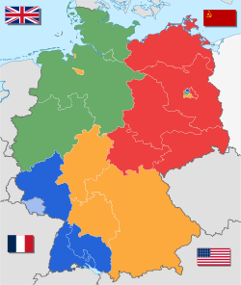
Partitioning
Korea and Vietnam split and partitioned
North and South Korea and Vietnam
Two major wars fought by US during Cold War
Korean War (1950-53) and Vietnam War (1964-1973)
Germany split into 4 zones and Berlin would also be split into 4 zones
The issue of Berlin nearly resulted in full-scale war in 1948-1949
Notes:
Korea and Vietnam were split and partitioned into North and South Korea/Vietnam. There were two major wars that were fought by the US during the Cold War. The Korean War that spanned from 1950-1953 and the Vietnam war which spanned from 1964-1973. German would be split into four different zones, as well as Berlin. The issue of Berlin nearly resulted in full-scale war in 1948-1949.

Slide 5
Containment

Slide 6
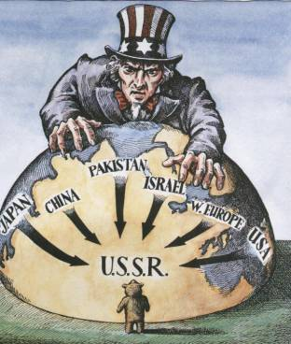
Containment
1947, George Kennan warns Truman of USSR
Soviet belief of outside world hostility and personal duty
Soviet growth in Europe and Middle East
Kennan as basis for Containment
Notes:
Secretary of State George Kennan warns President Truman of the USSR. The Soviets had a belief that the outside world was naturally hostile and it was their personal duty to take them over with force. Soviets grew in Europe and the in the Middle East and Kennan’s advise to Truman became the basis of Containment policy in the late 40s and early 50s.

Slide 7
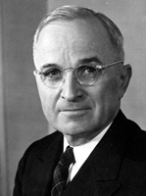
Truman Doctrine
20 years of foreign policy
“It must be the policy of the US to support free peoples who are resisting attempted subjugation by armed minorities or by outside pressures.”
Containment: Prevention of the spread of Communism
Truman asks Congress for money to support democracy in Turkey and Greece
Recognized Israel in 1948 as bastion of democracy in Middle East
Notes:
The Truman Doctrine is the basis of 20 years of foreign policy and states that “It must be the policy of the US to support free peoples who are resisting attempted subjugation by armed minorities or by outside pressures.” Containment policy stated that prevention of the spread of Communism. Truman would ask Congress for money to support democracy in Turkey and in Greece. Truman would also recognize Israel in 1948 as a bastion of democracy in the middle east.

Slide 8
Marshall Plan of 1947
Europe suffers from economic havoc of postwar era
USSR might have exploited
George Marshall invites Europe to create recovery plan
US assistance
Czechoslovakia forced to not participate by USSR
Congress did not take seriously until the Czech coup d’etat
$12.5 billion over four years in 16 nations
Most nations end up exceeding prewar outputs
Communism loses ground in France and Italy
Notes:
Europe suffers from economic havoc because of World War II and the US feared that the USSR would exploit these hardships to help spread Communism. George Marshall invites Europe to create a joint recovery plan that involved US assistance. Czechoslovakia forced to not participate by the USSR. Congress did not take proposal seriously until the Czech coup d’etat. The US would dedicate $12.5 billion over four years in 16 nations and most nations would end up exceeding prewar outputs. Communism would soon lose ground in France and Italy.

Slide 9
US Government Reorganization and Rearmament
National Security Act of 1947
Formed DoD, housed at Pentagon
National Security Council (NSC) and CIA formed by Truman
NSC Number 68 issued in response to Communist victory in China
Notes:
The National Security Act of 1947 would form the Department of Defense, headed by the Secretary of Defense (Current Secretary Jim Mattis) and would be housed at the Pentagon. Additionally, Truman would also form the National Security Council (NSC) and the Central Intelligence Agency (CIA). He would also issue NSC Number 68 In response to the growth of Communism in China.

Slide 10
US Government Reorganization and Rearmament
First ever peacetime military draft in 1948
“Voice of America” broadcasts behind the Iron Curtain
Goal: Promote Democracy
Atomic Energy Commission – Civilian control over nuclear development
POTUS has authority over atomic weapons
Notes:
The first ever peacetime military draft is implemented in 1948. The “Voice of America” broadcasts behind the Iron Curtain would begin with the goal of promoting democracy. Also, the Atomic Energy Commission would be created, giving civilian control over nuclear development and gives the president authority over atomic weapons.

Slide 11
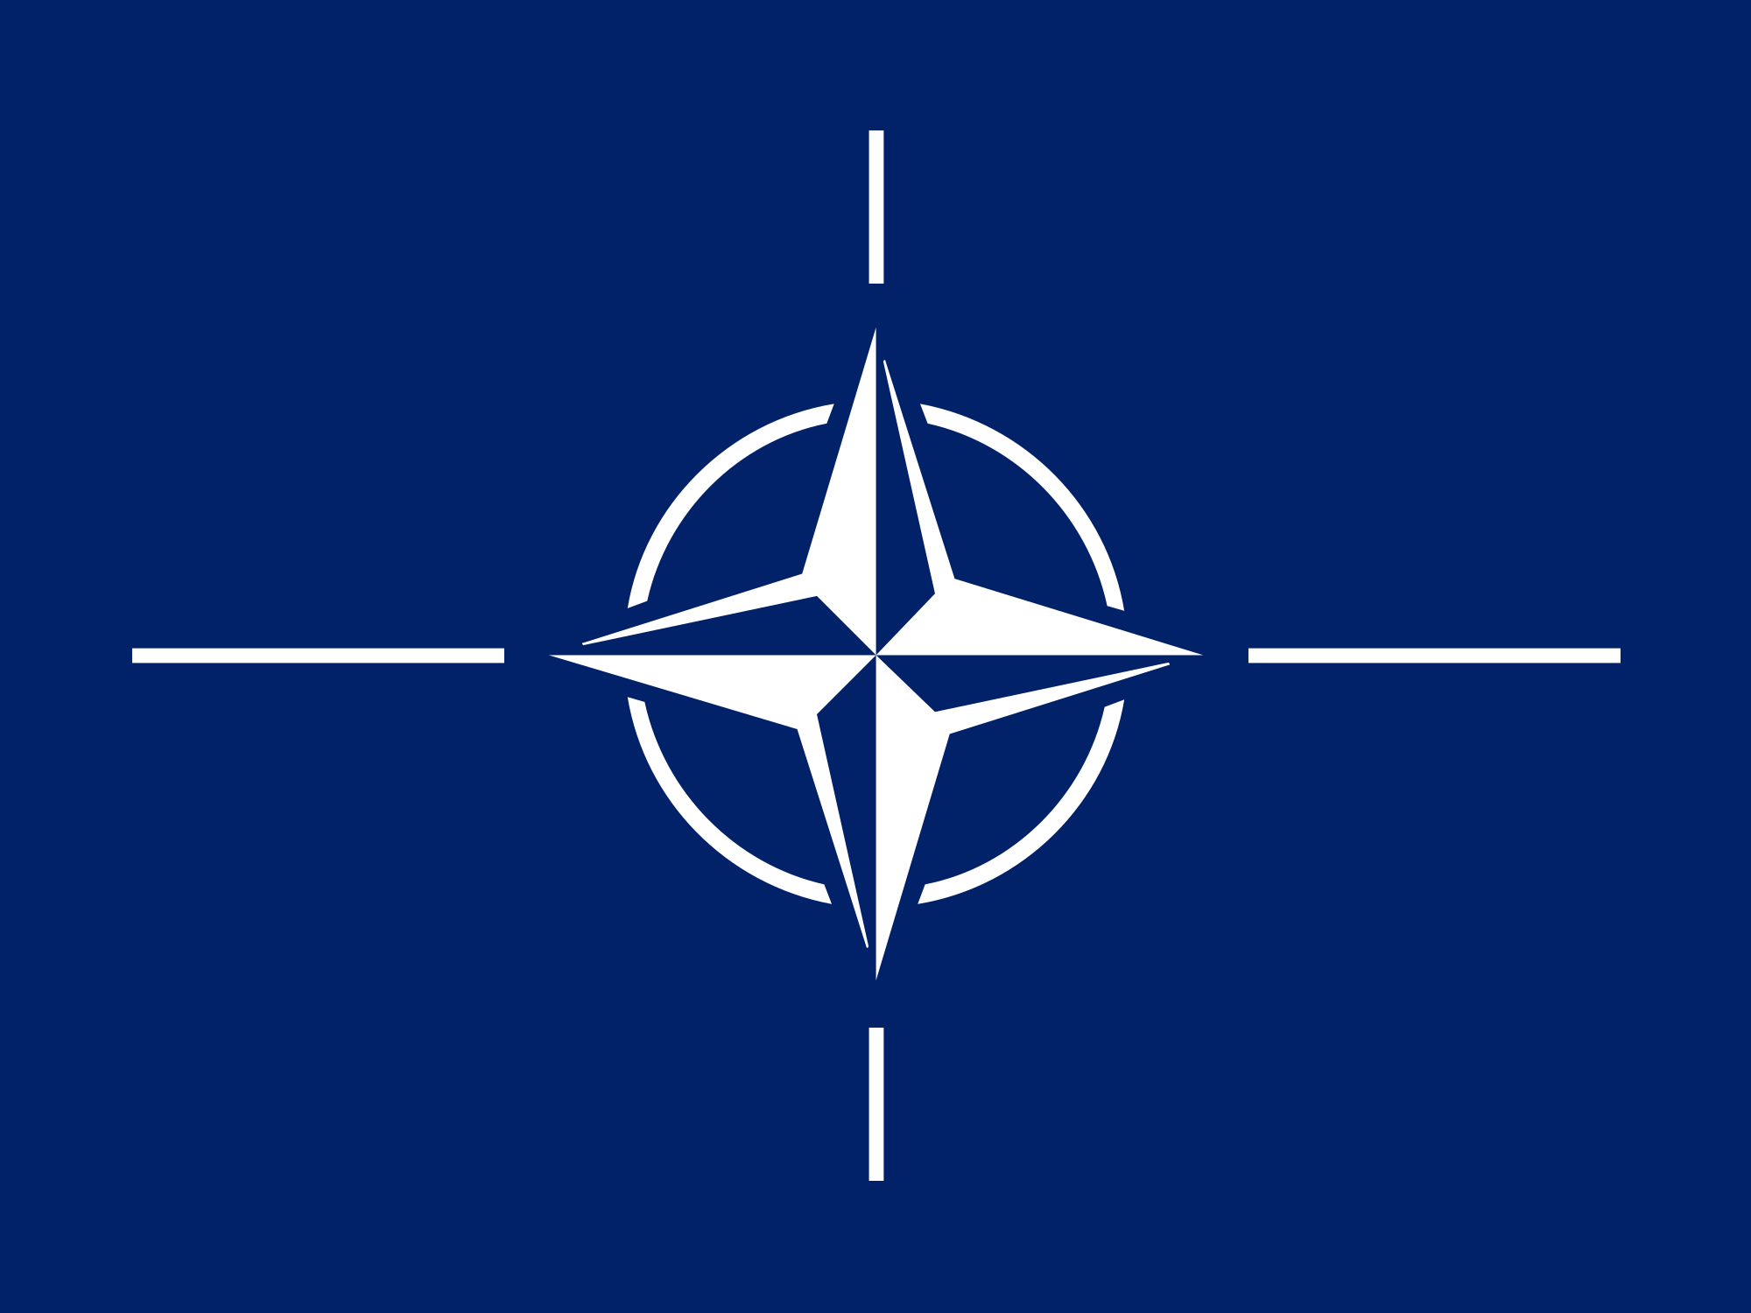
NATO
North Atlantic Treaty Organization – created in response to Berlin Crisis in 1949
US, France, Britain, Italy, Belgium, Netherlands, Luxembourg, Denmark, Norway, Portugal, Iceland, and Canada included and later Turkey, Greece, and West Germany
A threat to any NATO member would be met with force
USSR forms Warsaw Pact in response which included all Eastern Bloc nations
Notes:
The North Atlantic Treaty Organization, or NATO, is created in response to the Berlin Crisis in 1949. NATO would consist of many member nations including the US, France, Britain, Italy, Belgium, Netherlands, Luxembourg, Denmark, Norway, Portugal, Iceland, and Canada. Later, Turkey, Greece, and West Germany would join too. NATO stated that a threat to any NATO member would be met with force. In response, the USSR would form the Warsaw Pact which included all Eastern Bloc nations.

Slide 12
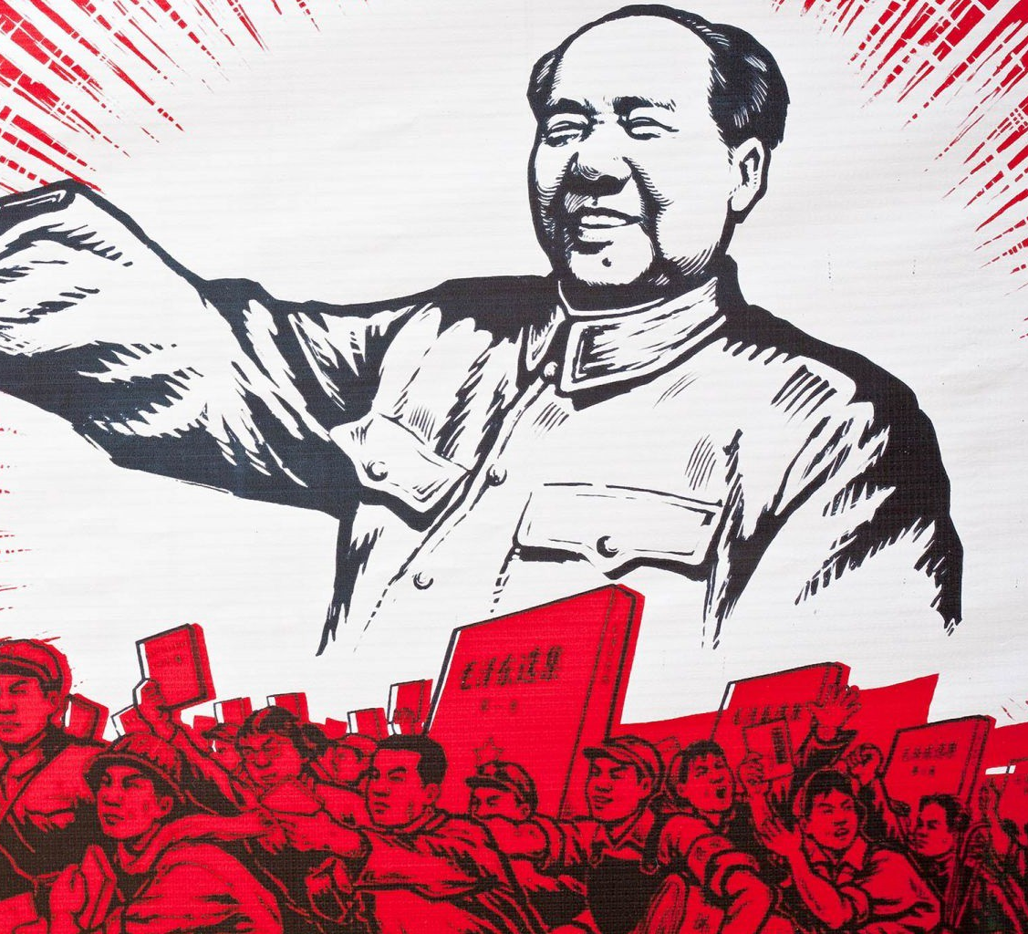
Communist China
US supported Nationalist Jiang Jieshi (Chang Kai Shek) during WWII
Mao Zedong’s forces defeated last of Jiang’s forces in 1949
Nationalists fled to Taiwan
Loss of China viewed as a failure of US Containment Policy
25% of the world’s population was now Communist
Notes:
The United States supported Nationalist Jiang Jieshi (Chang Kai Shek) during WWII. Mao Zedong’s forces defeated last of Jiang’s forces in 1949 and the Nationalists fled to Taiwan. The loss of China to Communism was viewed as a failure of US Containment policy as 25% of the world’s population was now Communist.

Slide 13
The Hydrogen Bomb
The United States explodes a hydrogen bomb in 1952
Many scientists felt that the H-Bomb had become an instrument of genocide
In 1953, Soviets successfully exploded an H-bomb and the Arms Race continued
The world now had two superpowers
Humankind had the ability in time to end civilization
Notes:
The United States exploded a hydrogen bomb in 1952 and many scientists felt that the h-bomb had become an instrument of genocide. In 1953, the Soviets successfully exploded an H-bomb and the Arms Race continued. The world now had two superpowers as a result of the H-bombs and for the first time in human history, man had the ability to end civilization.

Slide 14
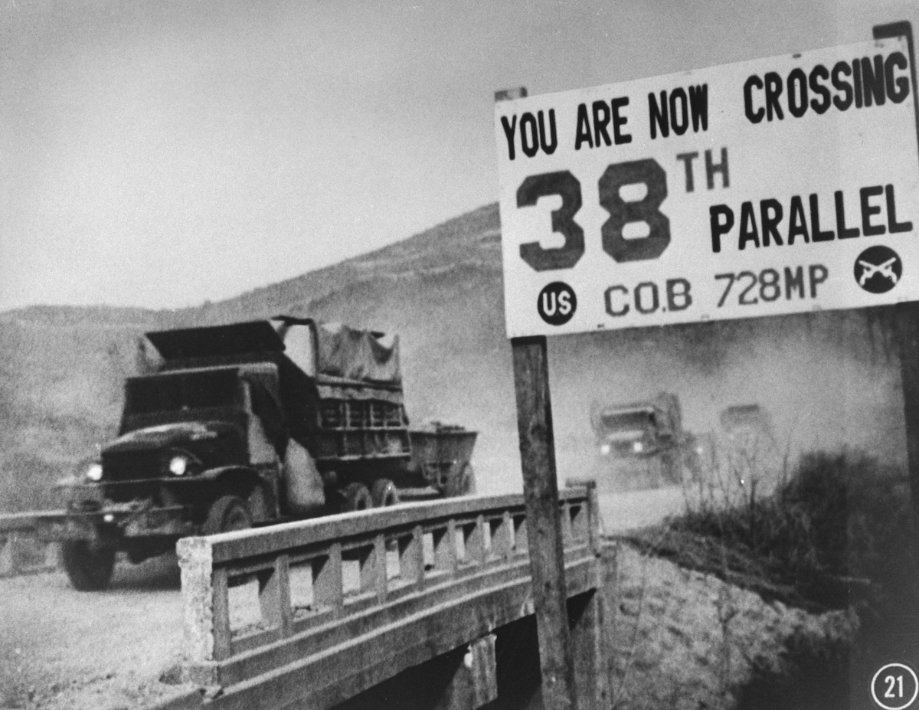
Korean War
Background
Russia occupied north
US occupied south
Dean Acheson: Korea outside US perimeter in Pacific. US forces reduced.
In 1950, the North Korean army with Soviet-made tanks invaded South Korea an took nearly all of the country
Notes:
During World War II, Russian troops occupied northern Korea while US troops occupied southern Korea. Dean Acheson claimed Korea was outside the essential US defense perimeter in the Pacific and US forces in Korea were reduced. In 1950, the North Korean army with Soviet-made tanks invaded South Korea and took nearly all of the country.

Slide 15
Korean War (continued)
Truman invokes NSC-68
4x defense spending and creation of massive military
UN Security Council (Russia absent) voted 9-0 to provide military aid to South Korea
General MacArthur directed a surprise amphibious landing at Inchon behind Korean lines
Notes:
President Truman would invoke NSC-68 which would quadruple US defense spending and create a massive military build beyond the purposes of war. The United Nations security council, with Russia absent, would vote 9-0 to provide military aid to South Korea. General MacArthur would direct a surprise amphibious landing at Inchon behind the Korean lines.

Slide 16
Korean War (continued)
November: 300k Chinese soldiers cross Yalu River; UN troops retreat across 38th parallel
Truman fires MacArthur wanted a limited war
US would seek specific objectives rather than total victory
No nuclear weapons
Original objective reemerged to restore the border between the North and South at 39th parallel
Invasion of China might mean Soviet retaliation in Europe or Asia
Decision might have averted a world war
MacArthur was against limited war: “No substitute for victory”
Significance: Civilian control of the US military was reaffirmed; the president was the commander-in-chief
Notes:
In November, 300,000 Chinese soldiers would cross the Yalu River into Korea, causing 300,000 UN to retreat back into the 38th parallel. In Korea, President Truman wanted a limited war. Truman wanted the US to seek specific objectives rather than total victory. No nuclear weapons were to be used. The original objective reemerged to restore the border between the North and South at 39th parallel. Truman knew that an invasion of China might mean a Soviet retaliation in Europe or Asia. The decision to have a limited war likely averted another world war. MacArthur was fired because he was against limited war and believed that there was no substitute for victory. The significance of this was that civilian control of the S military was reaffirmed and that president, not the generals, was the commander-in-chief.

Slide 17
Results of the Korean War
54,000 US soldiers and 3,000 UN soldiers dead; 103,000 UN soldiers wounded; 2 million civilians dead (mostly in South Korea); over 1.5 million dead Chinese and North Korean soldiers
The UN repelled North Korea’s attack on South Korea
The US successfully enforced its containment policy
Notes:
As a result of the Korean War, 54,000 US troops and 3,000 UN troops died. 103,000 UN soldiers were wounded. 2 million civilians died (mostly in South Korea) and over 1.5 million Chinese and North Korea soldiers died. The UN had repelled North Korea’s attack on South Korea and the US had successfully enforced its containment policy.

Slide 18
The 2nd Red Scare

Slide 19
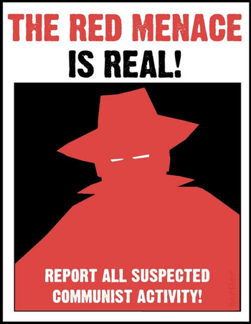
The Red Scare
American fears of communism and its sympathizers
Communism at home: fear of spies
Spread of Communism around the
Fear of Nuclear War
Fear of another depression
Demagogue politicians used fear for gain, such as McCarthy
American culture reflected these fears with movies
Invasion of the Body Snatcher, The Blob, Them
2nd Red Scare (first occurred after WW1 in 1919-1920 under Wilson)
Notes:
The Red Scare was about American’s fears of Communism and its sympathizers and the fear of Communism at home. The fear of spies infiltrating the government (such as Alger Hiss and the Rosenbergs). The fear of the spread of Communism around the world, especially in Eastern Europe, China, and Korea. The fear of nuclear war and the fear of another depression and that it might trigger the growth of communism. Some politicians used fear and the Red Scare for their own gain, more prominently Joseph McCarthy. Much of American culture reflected these fears with movies such as the Invasion of the Body Snatcher, The Blob, and Them. This was the second Red Scare (the first one occurred after WW1 in 1919-1920 under Wilson).

Slide 20
Smith Act of 1940
Advocating for the overthrow of the government made illegal
Immigrants who belonged to such organizations could be deported
The Truman administration used the law to jail leaders of the American Communist Party
11 Communists were brought to trial in New York in 1949 and sent to prison
Notes:
The Smith Act of 1940 made it illegal to advocate for the overthrow of the government with the use of force or to belong to an organization that advocates for such a position. Immigrants who belonged to such an organization could be deported. The Truman administration used the law to jail the leaders of the American Communist Party and 11 Communists were brought to trial in New York in 1949 and sent to prison.

Slide 21
House Un-American Activities Committee (HUAC) and Alger Hiss
HUAC was created in 1945 to root out communism in the US
Committee was sensationalistic, going after public figures in Hollywood
Liberals and members of the New Deal were targeted
The Senate counterpart to HUAC was also active in anti-communist investigations
Richard Nixon led the movement to indict Alger Hiss, a distinguished member of the “eastern establishment”
Hiss denied being a Communist supporter in the 1930s but was convicted of perjury in 1950
Nixon gained national prominence; he was elected vice president 5 years later
Notes:
The House of Representatives created the House Un-American Activities Committee (HUAC) in 1945 to try to root out communism in the United States. The Committee was sensationalistic and went after public figures in Hollywood. Liberals and members of the New Deal were targeted and the Senate counterpart of HUAC was also active in anti-community investigations. Richard Nixon, future president, led the movement to indict Alger Hiss, a distinguished member of the “eastern establishment.” Hiss denied being a Communist supporter in the 1930s but was later convicted of perjury in 1950. Nixon would gain national prominence and was elected Vice President 5 years later.

Slide 22
Truman’s Loyalty Program
Truman countered the committee with anti-communist plans of his own
The AG identified 90 “disloyal” organizations
Truman gave the FBI approval and resources to go after suspected “reds”
The Loyalty Review Board investigated more than 3 million federal employees
Loyalty oaths were increasingly demanded of employees, especially teachers
Many people believed their civil liberties were being suppressed
Government employees were forbidden to
Criticize US foreign policy, Advocate equal rights for women, Own books on socialism, and attend foreign films
Notes:
The Truman Administration countered the committee with anti-communist plans of his own. The Attorney General identified 90 so-called “disloyal” organizations and President Truman gave the FBI approval and the resources needed to go after suspected “reds.” The Loyalty Review Board investigated over 3,000,000 federal employees and loyalty oaths were increasingly demanded of employees, particularly teachers. Many people believed that their civil liberties were being suppressed and government employees were forbidden to criticize US foreign policy, advocate for equal rights for women, own books about socialism, and attend foreign films.

Slide 23
McCarran Internal Security Bill of 1950
Required communist-front organizations to register with the attorney general and prevented their members from defense work and travel abroad
Truman vetoed bill which authorized the president to arrest and detain suspicious persons during an “internal security emergency”
Many felt that this bill was a step towards a police state
Congress overrode Truman’s veto

Slide 24
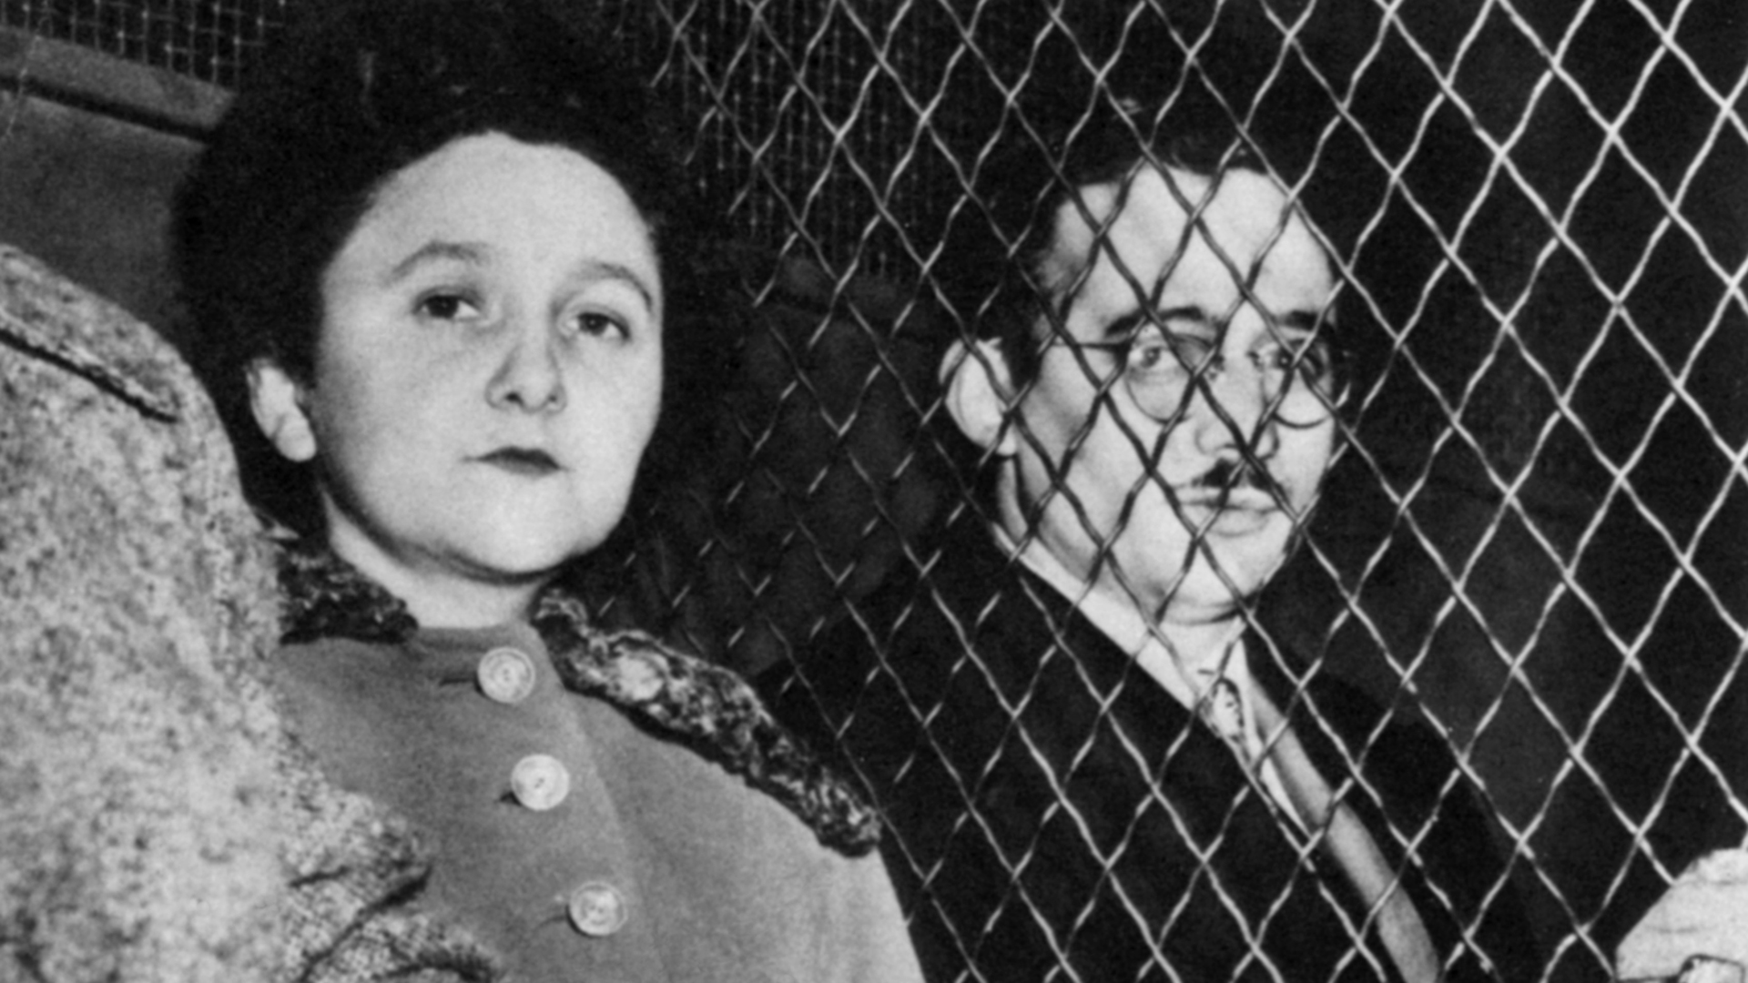
The Rosenbergs, 1954
Julius and Ethel Rosenberg were convicted and executed for giving atomic bomb secrets to the Soviets
Both were avowed communists
Americans were horrified that an American couple had sold out their country
Notes:
The Rosenbergs, Julius and Ethel Rosenberg, were charged, convicted, and executed for handing atomic bomb secrets to the Soviets. Both individuals were avowed communists and Americans were horrified that an American couple had sold out their nation.

Slide 25
Blacklisting
Many actors, writers, and directors had dabbled with the Communist Party in the 1930s when it was considered fashionable
10 of these movie industry people, the “Hollywood Ten” refused to testify and decided to go to prison rather than testifying to the HUAC, claiming protection from the Constitution
The industry responded by denying work to 250 actors, writers, and directors
Notes:
Many actors, writers, and directors had dabbled with the Communist Party in the 1930s because it was considered fashionable. 10 of these people, known as the “Hollywood Ten,” refused to testify and decided to go to a prison rather than testifying to the HUAC, claiming protection from the Constitution. The industry responded by denying work to 250 actors, writers, and directors.

Slide 26
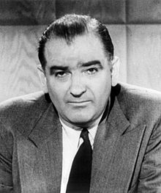
McCarthyism
Senator Joseph R. McCarthy (Wisconsin Republican) became America’s most notorious demagogue by playing on American’s fears of communism
Asserted that 200 unknown communists were in the State Department
Notes:
Senator Joesph R. McCarthy, a Republican from Wisconsin, became America’s most notorious demagogue by playing on American’s fears of communism. McCarthy asserted that 200 unknown communists were in the State Department.

Slide 27
McCarthy’s Accusations
He made sweeping accusations, employed guilt by association and used documents out of context (doctored photos and documents)
Public was convinced he was looking out for National Security
Was unable to substantiate his claims but ruined many government officials anyways
Almost no one was safe from accusations
Supporters tended to be Republican and blue-collar
Notes:
McCarthy made sweeping accusations. He employed guilt by association and used documents out of context and doctored photos and documents. The public was convinced he was looking out for National Security. He was unable to substantiate his claims but ruined the careers and lives of many government officials anyways. Almost no one was safe from accusations and his supporters tended to be Republicans and blue-collar workers.

Slide 28
McCarthy’s Accusations (continued)
Claimed the Democratic Party was guilty of 20 years of treason
Wanted Truman impeached for being soft on communism
Despite Truman Doctrine, Marshall Plan, NATO, Berlin Airlift, and Korean War
Claimed Secretary of State George Marshall was an instrument of a Soviet conspiracy
Hinted that Eisenhower was soft on communism
Slandered people and would publicly claim they were “gay as well as communist”
Notes:
McCarthy also claimed that the Democratic party was guilty of 20 years of treason. Senator McCarthy wanted President Truman impeached for being soft on communism, despite the Truman Doctrine, Marshall Plan, NATO, the Berlin Airlift, and the Korean War. He claimed the Secretary of State George Marshall was an instrument of a Soviet conspiracy and hinted that Eisenhower was soft on communism. He slandered people and would publicly claim they were “gay as well as communist.”

Slide 29
McCarthyism
McCarthy’s Senate hearing created an atmosphere of conformity and fear
Presidents Truman and Eisenhower despised McCarthy but did little to oppose him
McCarthy lost support when he went after the Army
Arthur Miller’s The Crucible was used as a metaphor for McCarthyism
Notes:
McCarthy’s Senate hearing created an atmosphere of conformity and fear. Presidents Truman and Eisenhower despised McCarthy but did little to oppose him, McCarthy lost support when he went after the Army. Arthur Miller’s The Crucible was used as a metaphor for McCarthyism.

